Slide 1
Data Visualization on Covid-19 Data
By
Rakesh Kumar Surapani

Slide 2
Content
About the Paper
Dataset
About Data Visualization -1
About Data Visualization -2

Slide 3
About the Paper
COVID-19 Data Visualization through Automatic Phase Detection
Reference - [https://dl.acm.org/doi/10.1145/3411756]
This article presents a new interactive visualization system to represent and compare rate of spread of COVID-19 pandemic across different countries over time.
This article contains a combination of bar and line graphs on Covid-19 US data.
This article also contains a combination of line graphs and pie charts to compare the different phases of the spread.

Slide 4
Dataset
Dataset for state wise comparative analysis using line chart is CSV data of Covid-19 India state-level-daily.
Reference[https://www.kaggle.com/imdevskp/covid19-corona-virus-india-dataset?select=state_level_daily.csv]
Another dataset is a CSV data of Covid-19 US-level-daily.
Reference[https://www.kaggle.com/sudalairajkumar/covid19-in-usa?select=us_covid19_daily.csv]

Slide 5
Data Visualization-1

Slide 6
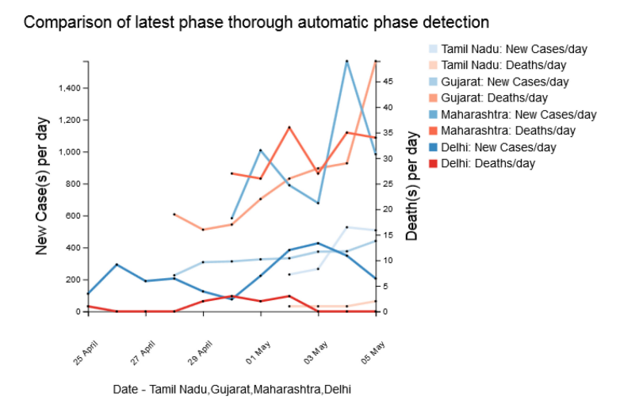
Data Visualization used in article

Slide 7
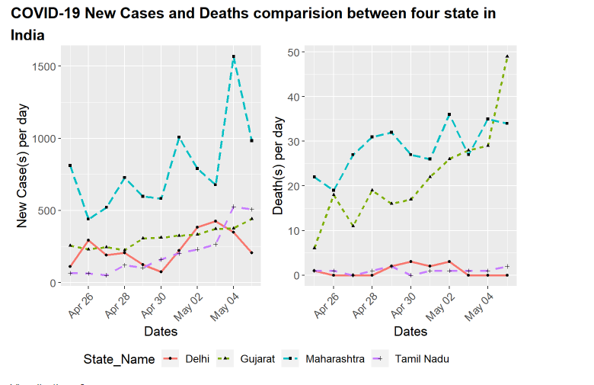
Data Visualization developed

Slide 8
Data Visualization - 2

Slide 9
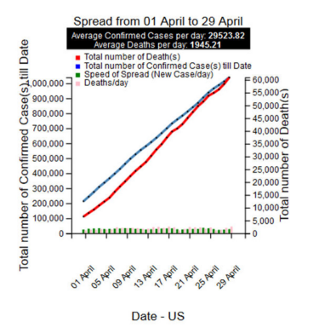
Data Visualization used in article

Slide 10
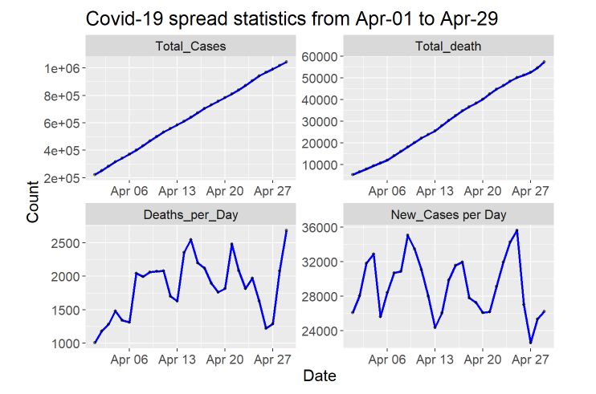
Data Visualization developed

Slide 11
Reference
COVID-19 Data Visualization through Automatic Phase Detection
Reference - [https://dl.acm.org/doi/10.1145/3411756]

